Slide 1

NoSQL databases
and MongoDB

Slide 2
Agenda
What is NoSQL databases
Different kinds of NoSQL databases
What is MongoDB?
Overview of MongoDB.
MongoDB’s key features
MongoDB’s core server and tools.
Installing MongoDB
Use cases and production deployment
Data Types, Schema Design and Data Modelling

Slide 3
Why NoSQL?
Relational databases → mainstay of business
Web-based applications caused spikes
explosion of social media sites (Facebook, Twitter) with large data needs
Example of such data : Personal user information, geo location data, social graphs , user generated contents , machine-logging data, sensor generated data etc
rise of cloud-based solutions such as Amazon S3 (simple storage solution)

Slide 4
Challenges with RDBMS
Hooking RDBMS to web-based application becomes trouble
Developers begin to front RDBMS with memcache or integrate other caching mechanisms within the application (ie. Ehcache)
As datasets grew, the simple memcache/MySQL model (for lower-cost startups) started to become problematic
Hence, developers look forward to improve existing applications and develop new applications which can meet the needs of Big Data

Slide 5
Issue with Scaling Up
Not possible to store and query when the dataset is just too big
RDBMS were not designed to be distributed
Began to look at multi-node database solutions
Known as ‘scaling out’ or ‘horizontal scaling’
Different approaches include:
Master-slave
Sharding
Scaling UP

Slide 6
Different RDBMS Cluster Approach
Master-Slave
Master handles all the write request because it must maintain the locks to guarantee roll back in case of failure.
All reads goes to the replicated slave databases
Reads from slave may be inconsistent as writes may not have been propagated down
Partition or sharding
Scales well for both reads and writes
Not transparent, application needs to be partition-aware
Can no longer have relationships/joins across partitions
Loss of referential integrity across shards

Slide 7
Other ways to scale RDBMS
Multi-Master replication
INSERT only, not UPDATES/DELETES
No JOINs, thereby reducing query time
This involves de-normalizing data
In-memory databases

Slide 8
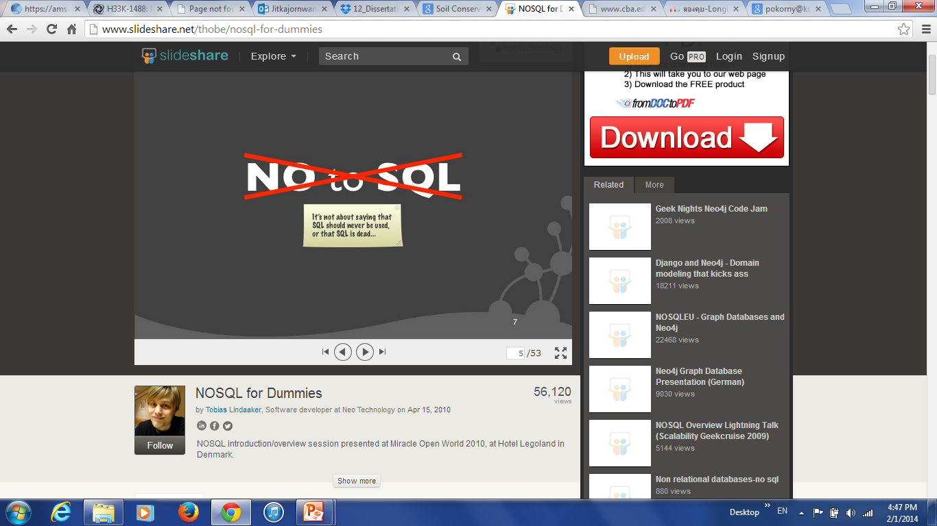
What is NoSQL?
Stands for Not Only SQL
The term NOSQL was given by Carl Strozzi in 1998 to name his file-based database
It was again re-introduced by Eric Evans when an event was organized to discuss open source distributed databases
Eric clarified later that NoSQL does not mean “No to SQL”
NoSQL means seeking alternatives for the relational databases specially for those use cases for which RDBMS are a bad fit.

Slide 9
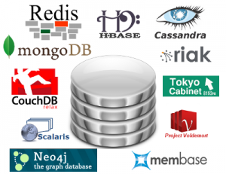
Features of NoSQL
non-relation based , no primary and foreign key relationship
Either don’t require schema or provide flexible schema
data are replicated to multiple nodes, data are partitioned too
down nodes easily replaced
no single point of failure
horizontal scalable
open-source software
massive write performance
fast key-value access

Slide 10
Types of NoSQL databases
Key-value
Example: DynamoDB, Voldermort, Scalaris
Document-based
Example: MongoDB, CouchDB
Column-based
Example: BigTable, Cassandra, Hbase
Graph-based
Example: Neo4J, InfoGrid
“No-schema” is a common characteristics of most NOSQL storage systems
Provide “flexible” data types

Slide 11
Benefits of NoSQL databases
High Scalability : Ability to execute more and more queries and store more and more data without having any upper limit.
High Availability : Ability to run Read/Write queries even when some servers are down

Slide 12
Disadvantage of NoSQL databases
Don’t fully support relational features
Normalization can’t be used, so No JOIN Queries
no referential integrity constraints
Non-Availability of SQL query language
More programing is needed to work with these DBs
NoSQL don’t follow and provide ACID properties
They provide fewer guarantees by following CAP theorem
No easy integration with applications that needs JDBC or ODBC drivers

Slide 13
Who are users of NoSQL
All the e-commerce companies such as Flipkart, Amazon, Walmart etc use
NoSQL database for storing huge volume of data and large amount of request from user.
All the Cab aggregator companies such as OLA and UBER
The mobile app companies like Kobo and Playtika
Consumer appliances companies such as LG, Samsung etc use NoSQL for IOT use cases
NOSQL has been used by some of the mobile gaming companies like, electronic arts, zynga and tencent for Social Gaming use cases

Slide 14
Tradeoff in Cluster Databases
ACID
A DBMS is expected to support “ACID transactions,” processes that are:
Atomicity: either the whole operation is performed, or none is
Consistency: Whenever clients reads the data it will be consistent
Isolation: one operation or transaction at a time by holding locks
Durability: once data is committed, DBs will safely keep this data even in the case of process crash
CAP
Consistency: all the nodes on cluster has the same copies
Availability: cluster always accepts reads and writes even if some nodes are down
Partition tolerance: guaranteed properties are maintained even if cluster gets divided into 2 or more partitions because of network failures.

Slide 15
CAP Theorem
Brewer’s CAP Theorem:
For any distributed cluster, it is “impossible” to guarantee simultaneously all of these three properties
You can have at most two of these three properties for any distributed shared data system
Large Cluster will “partition” at some point due to network failures :
If database is designed to provide partition tolerance, then Database by default will either provide C(Consistency) or A(Availability) but not the both .

Slide 16
CAP Theorem?
Consistency
All client always have the same view of the data
2 types of consistency:
Strong consistency – ACID (Atomicity, Consistency, Isolation, Durability)
Weak consistency – BASE (Basically Available Soft-state Eventual consistency)
Availability
Consistency
Partition tolerance

Slide 17
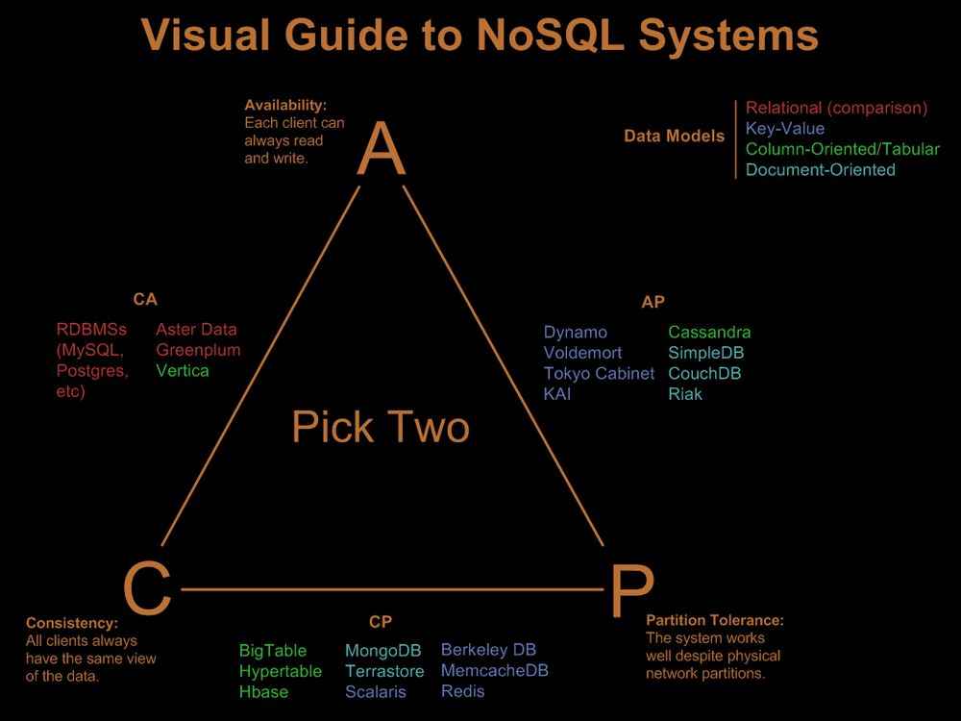
CAP

Slide 18
Key Value Databases
Key-value stores are the simplest NoSQL databases.
They are like a dictionary, stores every item as an attribute name (or "key"), together with its value.
Examples of key-value stores are Riak and Voldemort.
Some key-value stores, such as Redis, allow each value to have a type, such as "integer", which adds functionality.
Key-value NoSQL databases are ideal for database for lookup queries with extremely quick and optimized retrieval

Slide 19
Document Databases
{Name:“Michael", Address:“FlatNo 112,Waterfront Aparment ,NYK,USA”,Grandchildren: {Claire: "7", Barbara: "6", "Magda: "3", "Kirsten: "1", "Otis: "3", Richard: "1“} Phones: [ “123-456-7890”, “234-567-8963” ] }
Example: MongoDb,CouchBase etc

Slide 20
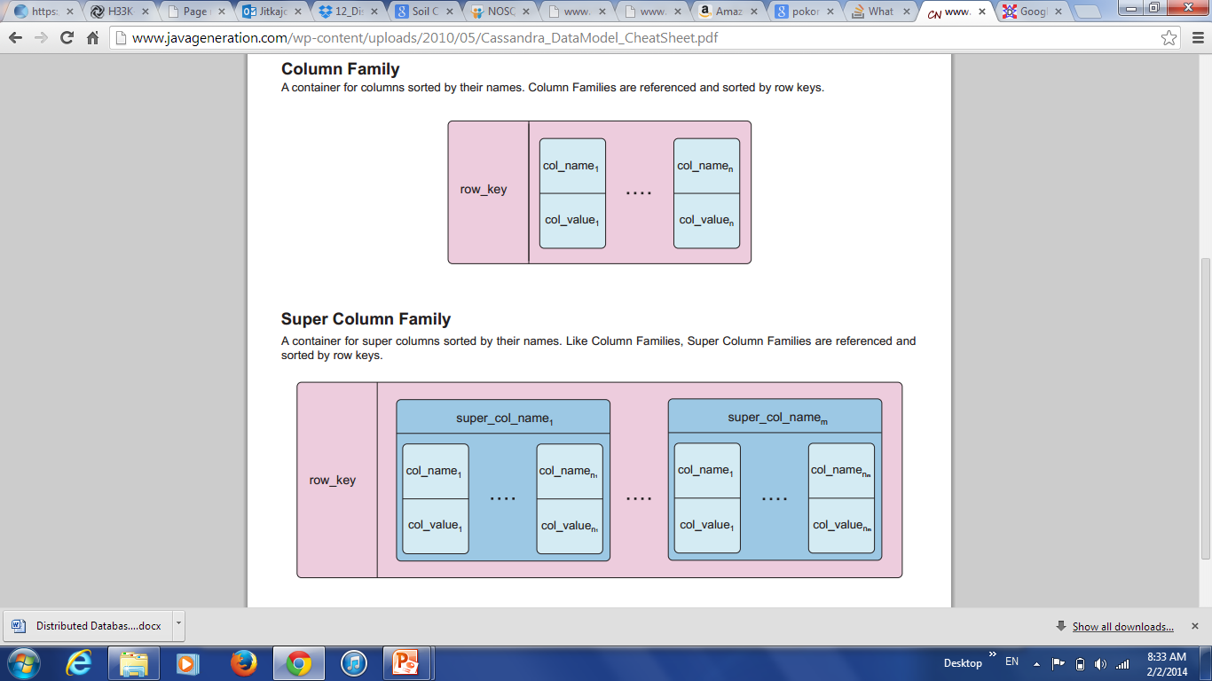
Columnar Databases
Based on Google’s BigTable paper, they are like column oriented relational databases (store data in column order)
Tables similarly to RDBMS, but handle semi-structured
Data model:
Collection of Column Families
Column family = (key, value) where value = set of related columns (standard, super)
indexed by row key, column key and timestamp

Slide 21
Columnar Databases
One column family can have variable numbers of columns
Cells within a column family are sorted “physically”
Very sparse, most cells have null values
Comparison: RDBMS vs column-based NOSQL
Query on multiple tables
RDBMS: must fetch data from several places on disk and glue together
Column-based NOSQL: only fetch column families of those columns that are required by a query (all columns in a column family are stored together on the disk, so multiple rows can be retrieved in one read operation → data locality)
Example : Hbase, Cassandra, HyperTable etc

Slide 22
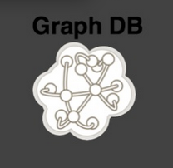
Graph Databases
Focus on modeling the structure of data (interconnectivity)
Scales to the complexity of data
Inspired by mathematical Graph Theory (G=(E,V))
Data model:
(Property Graph) nodes and edges
Nodes may have properties (including ID)
Edges may have labels or roles
Single-step vs path expressions vs full recursion
Example:
Neo4j, FlockDB, Pregel, InfoGrid …

Slide 23
What is MongoDB?
MongoDB is a document-oriented database
MongoDB replaces the concept of a “row” with a more flexible model, the “document.”
MongoDB stores data in the form of BSON(binary form of JSON)
Document-oriented approach allows to store complex hierarchical relationships with a single record in the form of nested JSON
This approach suits application developers of modern object-oriented languages as Java, Java Script based framework(AngularJS, RectJS), C++ etc
MongoDB is also schema-free: it is not necessary to define collection attributes before writing data into it.
This provide developers a lot of flexibility to handle evolving data models.

Slide 24
MongoDB Usecases
Personalization
Mobile
Internet of things
Real time Analytics
Web Applications
Content Management
Catalog
Single View

Slide 25
What is JSON?
JSON : JSON (JavaScript Object Notation) is a lightweight data-interchange format.It is easy for humans to read and write.
JSON is a text format and language independent, It also uses object concept that are familiar to programmers of different object oriented languages such as Java,C#,C++ etc
JSON supports all the basic data types you’d expect: numbers, strings, and boolean values, as well as arrays and hashes
Document databases such as MongoDB use JSON documents in order to store records, just as tables and rows store records in a relational database
A JSON database returns query results that can be easily parsed, with little or no transformation, directly by JavaScript and most popular programming languages – reducing the amount of logic you need to build into your application layer

Slide 26
Example of JSON
{
"_id" : 1,
"name" : { “GreatLearning"},
"customers" : [ “Genpact", “Accenture", “Wipro", “Infosys" ],
“courses" : [
{ "name" : “Data Science with SAS",
"domain" : “Statistics and Analytics "
},
{ "name" : “Big Data Specialization",
"domain" : “Hadoop eco-system analytics"
}
]
}

Slide 27
Why MongoDB stores data as BSON
MongoDB stores data or document in binary-encoded format called BSON.
BSON is a bin­ary-en­coded seri­al­iz­a­tion of JSON-like doc­u­ments.
BSON sup­ports the em­bed­ding of doc­u­ments and ar­rays with­in oth­er doc­u­ments and ar­rays
BSON also supports additional data types that are not part of the JSON spec such as BinData and Date data type
BSON is designed to be lightweight , traversable and efficient

Slide 28
MongoDB Structure
RDBMS |  | MongoDB
Database |  | Database
Table, View |  | Collection
Row or Record |  | Document (JSON, BSON)
Column |  | Field
Index |  | Index
Join |  | Embedded Document
Foreign Key |  | Reference
Partition |  | Shard

Slide 29
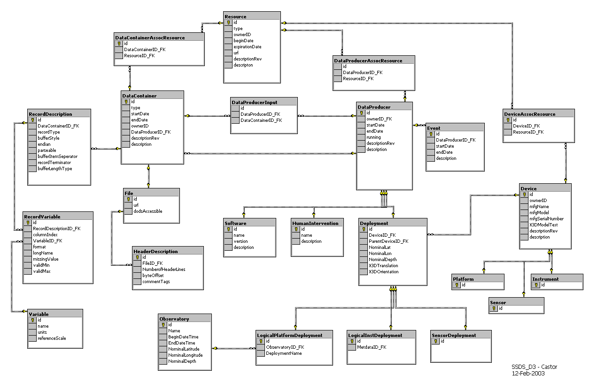

MongoDB is easy to use
{
title: ‘MongoDB’,
contributors: [
{ name: ‘Mukesh Kumar’,
email: ‘mukesh@greatlearning.com’ },
{ name: ‘Laxman L’,
email: ‘laxman@gmail.com’ }
],
model: {
relational: false,
awesome: true
}
}
MongoDB’s nested model
RDBMS ER Diagram

Slide 30

Schema Free
MongoDB does not need any pre-defined data schema
Every document could have different data!
{name: “Marbluetin”,
eyes: “black”,
birthplace: “Bangalore”,
aliases: [“Raju”, “Mukku”],
loc: [31.7, 53.4]
boss: ”bill”}
{name: “Jim”,
eyes: “blue”,
loc: [43.2, 73.4],
boss: “bill”}
{name: “Mike”,
aliases: [“el diablo”]}
{name: “Michael”,
pizza: “DiGiorno”,
height: 56,
loc: [44.6, 71.3]}
{name: “Venus”,
hat: ”yes”}

Slide 31
How to scale database?
Applications data are growing at an incredible pace
Due to Rapid pace of digitalization ,Advances in sensor technology, increases in available bandwidth, and the popularity of smart devices
where even small scale applications need to store more data than many databases were meant to handle
A terabyte of data, once considered huge data, is now commonplace
Application developers face a difficult decision: how should they scale their databases to make their application scalable

Slide 32
MongoDB is designed for scale out
MongoDB is designed to scale out from the beginning.
Using Sharding, it can split up data across multiple servers
Sharding in MongoDB, can balance data and load across a cluster, redistributing documents automatically
This helps developers to focus on programming the application, not scaling it
When they need more capacity, they can just add new shards to the cluster

Slide 33
MongoDB Features
Ad hoc queries
Secondary Indexes
Replication
Auto-Sharding
Querying
Fast In-Place Updates
Aggregation
Capped Collection

Slide 34
Collection and Database
A collection is a group of documents.
Collections are schema-free, documents within a single collection can have different attributes or fields
However, Keeping different kinds of documents within the same collection can be a nightmare for developers and admins.
Grouping similar documents together in the same collection is recommended for application development
MongoDB groups collections into databases. A MongoDB database or cluster can host several databases, each of which can be thought of as completely independent.
A good rule of thumb is to store all data for a single application in the same database

Slide 35
Insert Operation
When we perform an insert, the application driver in the application code converts the data structure into BSON then sends to the database
database accepts BSON and checks for an "_id" key and validate that the document’s size does not exceed 16MB
All the data validation will be performed by application Drivers at the client side

Slide 36

Retrieval Operation
db.collection.find() method retrieves documents from a collection & it returns a cursor to the retrieved documents.
The method takes both the query criteria and projections and returns a cursor to the matching documents.
We can change the query to impose limits, skips, and sort orders
The order of documents returned by a query is random unless we specify a sort().
db.items.find( {available: true },{item:1,} ).limit(5)

Slide 37
Retrieval Operation
findOne() : Find the first record in the document
pretty() method can be used to display the output in a formatted manner
db.collection.find().pretty()
db.collection.find() or db.collection.find({}) selects all documents in the collection:
Specify Equality Condition : use the query document { <field>: <value> } to select all documents that contain the <field> with the specified <value>.
db.items.find( {available: true } )

Slide 38
Query Operators
Specify Conditions Using Query Operators: A query document can use the query operators to specify conditions in a MongoDB query.
If you have more than one possible value to match for a single key, use an array of criteria with "$in".
db.items.find( {available : { $in: [true, false ] } } )
Specify AND Conditions: A compound query can specify conditions for multiple fields
db.items.find( {available: true, soldQty: { $lt: 900 } } )

Slide 39
OR, AND Operators
Specify OR Conditions
Using the $or operator, you can specify a compound query that joins each clause with a logical OR conjunction
db.items.find({ $or: [ {soldQty : { $gt: 500 } }, { available:true } ] }).
Specify AND as well as OR Conditions
db.items.find({ available:true,$or: [ {soldQty : { $gt: 200 } }, {item: “Book” } ]})
"$not" is a metaconditional: it can be applied on top of any other criteria.
> db.items.find({“_id" : {"$not" : {"$mod" : [4, 1]}}})

Slide 40
Regular expression
Regular Expressions: Regular expressions are useful for flexible string matching
For example, if we want to find all items whose whose value starts with “Pe” i.e Pen and Pencil
db.items.find({item:/pe/i})
If we want to match not only various capitalizations of Pen, but also for Pencil
db.items.find({item: /Pen?/i})

Slide 41
Limit , Skip and Sorting
To set a limit, chain the limit function onto your call to find
db.c.find().limit(3)
If we want to skip the first three matching documents and return the rest of the matches
db.c.find().skip(3)
Sort takes an object: a set of key/value pairs where the keys are key names and the values are the sort directions.
Sort direction can be 1 (ascending) or -1 (descending).
db.c.find().sort({username : 1, age : -1})

Slide 42
Update
db.collection.update() method modifies existing documents in a collection
db.collection.update() method can accept query criteria to determine which documents to update
db.collection.update() method either updates specific fields in the existing document or replaces the document
By default, the db.collection.update() method updates a single document
To change a field value, MongoDB provides update operators, such as $set to modify values.
The following updates the model field within the embedded details document.
db.inventory.update({ item: "ABC1" },{ $set: { "details.model": "14Q2" }},{multi:true})

Slide 43
Upsert
An upsert is a special type of update. If no document is found that matches the update criteria, a new document will be created by combining the criteria and update documents.
db.items.update({“item" : “Bag"}, {"$inc" : {“soldQty" : 1}}, {upsert:true})
Updates, by default, update only the first document found that matches the criteria
To modify all of the documents matching the criteria, we need to pass true as the fourth parameter to update.
db.users.update({item: "10/22/1978"},{$set : {gift : "Happy Birthday!"}}, false, true)

Slide 44
Remove Operation
db.courses.remove() removes all the documents from the collection
This doesn’t remove the collection and any indexes created on it.
The remove function optionally takes a query document as a parameter
db.items.remove({“item" : “Bag”)
By default, db.collection.remove() method removes all documents that match its query
However, the method can accept a flag to limit the delete operation to a single document
db.items.remove({" item" : “Bag},1)
db.courses.drop() will drop whole collection and indexes created on it.

Slide 45
Schema Design
By-default, MongoDB’s do not enforce any kind of structure on the documents of the collection
This flexibility helps the mapping of documents to an entity or an object.
Different document in the collection can have different keys and types
In general, however, the documents in a collection share a similar structure.
We should data balance the needs of the application, the performance characteristics of the database engine, and the data retrieval patterns while doing data modelling.
The application usage pattern of the data (i.e. queries, updates, and processing of the data) as well as the inherent structure of the data itself matters most in designing data model.

Slide 46
Reference data model
The key decision in designing data models for MongoDB applications revolves around the structure of documents and how the application represents relationships between data
There are two tools that allow applications to represent these relationships: references and embedded documents.
References: References store the relationships between data by including links or references from one document to another.
Applications can resolve these references to access the related data. Broadly, these are normalized data models.

Slide 47
Reference data model example
{
_id: “12”,
Name: “Apple”,
“Camera type”: 13MP
}
SMART
{ _id: <ObjectId1>,
Phone_ids: [“12”,”13”],
}
{
_id: “13”,
Name: “SamSung”,
“Bluetooth”: “Yes”;
}
Basic
MobilePhones

Slide 48
Embedded data model
Embedded documents capture relationships between data by storing related data in a single document structure.
MongoDB documents make it possible to embed document structures in a field or array within a document
Grouping documents of the same kind together in the same collection allows for data locality
In general, use embedded data models when one-to-one, one-to-many relationships between entities. In these relationships the “many” or child documents always appear with or are viewed in the context of the “one” or parent documents
In general, embedding provides better performance for read operations, as well as the ability to request and retrieve related data in a single database operation.
Embedded data models make it possible to update related data in a single atomic write operation

Slide 49
Embedded data model
{
productdetail: [
{
_id: 12,
Name: “Apple”,
Price: “45,000”
},
{
_id: 13,
Name: “SamSung”,
Price: “40,000”
}
]
}

Slide 50
Data Types
Null : Null can be used to represent both a null value and a nonexistent field:{"x”: null}
Undefined : Undefined can be used in documents as well (JavaScript has distinct types for null and undefined):
{"x" : undefined}
Boolean: There is a boolean type, which will be used for the values 'true' and 'false’: {"x" : true}
32-bit integer : This cannot be represented on the shell.
64-bit integer : Again, the shell cannot represent these.
64-bit floating point number : All numbers in the shell will be of this type

Slide 51
Data Types
maximum value: BSON contains a special type representing the largest possible value.
minimum value : BSON contains a special type representing the smallest possible value.
ObjectId : These values consists of 12-bytes
String: BSON strings are UTF-8.
Symbol: This type is not supported in the Mongo shell
Timestamps: BSON has a special timestamp type for internal MongoDB use and is not associated with the regular Date type
Date : BSON Date is a 64-bit integer that represents as the Unix epoch (Jan 1, 1970)
regular expression: Documents can contain regular expressions as value of the field using JavaScript’s regular expression syntax: {"x" : /learn/i}

Slide 52
Data Types
Code : Documents can also contain JavaScript code as field value:
{“y" : function() { /* java script code ... */ }}
Binary data: Binary data is a string of arbitrary bytes.
Array: Sets or lists can be represented as arrays:
{“courses" : [“Big Data Specialist", “Data Science with R", “HR Analytics"]}
embedded document
Documents can contain nested documents, embedded as values in a parent or outer document: {"course_duration" : {" Big Data Specialist " : “72 Hrs"}}

Slide 53

Mongo name has come “humongous”

Slide 54
Secondary Indexes
Secondary indexes in MongoDB are implemented as B-trees.
B-tree indexes are optimized for a variety of queries, including range scans and queries with sort clauses
By permitting multiple secondary indexes, MongoDB allows users to optimize for a wide variety of queries
With MongoDB, you can create up to 64 indexes per collection
ascending, descending, unique, compound-key, and even geospatial indexes are supported

Slide 55
Different Indexes Types
MongoDB provide support for different kinds of ndexes to support specific types of data and queries.
Default _id
Single Field
Compound Index
Multikey Index
Geospatial Index
Text Indexes
Hashed Indexes

Slide 56
Single field Index
MongoDB provides complete support for indexes on any field in a collection of documents
By default, all collections have an index on the _id field
Applications and users may add additional indexes to support important queries and operations.
The following command creates an index on the name field for the users collection
db.users.createIndex( { “name" : 1 } )

Slide 57
Compound Indexes
MongoDB supports creating compound indexes by combing multiple fields
Compound indexes can support queries that match on multiple fields.
db.productsInfo.createIndex( { "itemName": 1, “noOfItems": 1 } )
The order of the fields in a compound index is very important.
Documents sorted first by the values of the first field and, within each value of the first field, sorted by values of the second field
MongoDB imposes a limit of 31 fields for any compound index

Slide 58
Multikey Indexes
Multikey index is supported on a field that holds an array value
MongoDB creates an index key for each element in the array
Multikey indexes helps running efficient queries against array fields
Multikey indexes can be generated over arrays that hold both scalar values (e.g. strings, numbers) and nested documents.
db.collectionName.createIndex( { <field>: < 1 or -1 > } )
if any indexed field is an array then MongoDB automatically creates a multikey index

Slide 59
Hashed Indexes
Hashed indexes stores hash values of the indexed field.
Hash Index can’t be created on multi-key (i.e. arrays) field
The hashing function flattens embedded documents and generate the hash value
MongoDB can use the hashed index to support equality queries
Hashed indexes do not support range queries
Hashed indexes support sharding a collection using a hashed shard key
Using a hashed shard key to shard a collection ensures a more even distribution of data.
db.items.createIndex( { item: "hashed" } )

Slide 60
TTL(Time to Live) Indexes
TTL indexes are special single-field indexes to automatically remove documents from a collection after a certain amount of time.
It is useful for certain types of data such as application and server logs, and session information that only need to persist in a database for a finite amount of time.
Use the db.collection.createIndex() method with the expireAfterSeconds option on a field whose value is either a date or an array that contains date values
db.eventlog.createIndex( { "lastModifiedDate": 1 }, { expireAfterSeconds: 3600 } )
TTL indexes are a single-field indexes. Compound indexes do not support TTL

Slide 61
Unique Indexes
Using unique index, MongoDB rejects all documents that contain a duplicate value for the indexed field
db.items.createIndex( { “item": 1 }, { unique: true } )
If you use the unique constraint on a compound index, then MongoDB will enforce uniqueness on the combination of values rather than the individual value for any or all values of the key.
It stores a null value for the document, If a document does not have a value for the indexed field in a unique index
Because of the unique constraint, MongoDB will only permit one document that lacks the indexed field
we can also combine the unique constraint with the sparse index to filter these null values from the unique index and avoid the error

Slide 62
Text Indexes
A MongoDB provides text indexes to support text search of string content in documents of a collection
Text indexes can be created on any field whose value is a string or an array of string elements
To perform queries that access the text index, use the $text query operator.
To create a text index on a field “customer_name” that contains a string or an array of string elements of the customer_info collection:
db.customer_info.createIndex({”customer_name”: “text”})
To perform the text search
db.customer_info.find({$text:{$search:”John”}})
A collection can have at most one text index.
.

Slide 63
Multi Languages Text Search
Supported Languages and Stop Words
Mongo DB supports text search for various languages and drop language-specific stop words
For English language it uses simple language-specific suffix stemming and drop stop words like “the”, “an”, “a”, “and”, etc.)
db.quotes.createIndex({ content : "text" }, default_language: "spanish" })
Text Search Languages: Danish,dutch,English,finish, French, German,Italian, Norwegian, Portuguese, Romanian, Russian, Spanish. Swedish,Turkish, Hungarian, Portuguese

Slide 64
Geospatial Indexes
MongoDB provides a special type of index for coordinate plane queries, called a geospatial index
db.collection.createIndex( { <location field> : "2dsphere" } )
Geospatial Query Operators
Inclusion: MongoDB can query for locations contained entirely within a specified polygon. Inclusion queries use the $geoWithin operator.
Intersection : MongoDB can query for locations that intersect with a specified geometry. These queries apply only to data on a spherical surface. These queries use the $geoIntersects operator.
Proximity MongoDB can query for the points nearest to another point. Proximity queries use the $near operator.

Slide 65
Geospatial $geoWithin Query
The $geoWithin operator queries for location data found within a GeoJSON polygon. Your location data must be stored in GeoJSON format. Use the following syntax:
db.<collection>.find( { <location field> : { $geoWithin :{ $geometry :{ type : "Polygon" ,coordinates : [ <coordinates> ]} } } } )
The following example selects all points and shapes that exist entirely within a GeoJSON polygon:
db.places.find( { loc :{ $geoWithin :{ $geometry :{ type : "Polygon" ,coordinates : [ [[ 0 , 0 ] ,[ 3 , 6 ] ,[ 6 , 1 ] ,[ 0 , 0 ]] ]} } } } )

Slide 66
Geospatial Proximity Query
Proximity queries return the points closest to the defined point and sorts the results by distance. A proximity query on GeoJSON data requires a 2dsphere index
To query for proximity to a GeoJSON point, use either the $near operator or geoNear command. Distance is in meters.
db.<collection>.find( { <location field> :{ $near :{ $geometry :{ type : "Point" ,coordinates : [ <longitude> , <latitude> ] } ,$maxDistance : <distance in meters>} } } )
The geoNear command uses the following syntax:
db.runCommand( { geoNear : <collection> ,near : { type : "Point" ,coordinates: [ <longitude>, <latitude> ] } ,spherical : true } )
To select all grid coordinates in a “spherical cap” on a sphere, use $geoWithin with the $centerSphere operator.
db.<collection>.find( { <location field> :{ $geoWithin :{ $centerSphere :[ [ <x>, <y> ] , <radius> ] }} }

Slide 67
Sparse Indexes
Sparse indexes only contain entries for documents that have the indexed field, even if the index field contains a null value.
It ignores and skips over those document which don’t have the indexed field.
The index is called as “sparse” because it does not include all documents of a collection.
db.sales.createIndex( { “sales_id": 1 }, { sparse: true } )
2d (geospatial) and text indexes are sparse by Default
Sparse and unique Properties: An index that has both sparse and unique properties defined,prevents collection from having documents with duplicate values for a field but allows multiple documents that omit the key.

Slide 68
Index Creation
By default, creating an index blocks all other operations by holding X exclusive lock on that collection
The Collection that holds the collection is unavailable for read or write operations until the index build completes.
For potentially long running index building operations, consider the creating the indexes in the background
db.people.createIndex( { zipcode: 1}, {background: true} )
By default, background is false for building MongoDB indexes.
You can combine the background option with other options, as in the following:
db.people.createIndex( { zipcode: 1}, {background: true, sparse: true } )

Slide 69
Removing an Index
To remove an index from a collection use the dropIndex() method
db.accounts.dropIndex( { "tax-id": 1 } )
You can also use the db.collection.dropIndexes() to remove all indexes, except for the _id index
db.items.dropIndexes()

Slide 70
References:
https://docs.mongodb.com/manual/tutorial/

Slide 71
Thank You

